Slide 1




Everything data.
Hibernate
A Complete Java ORM Project.

Slide 2

Overview
Hibernate Integration with MySQL
01
Set up Hibernate ORM in a Java project to manage database operations without writing SQL manually.
This project is a comprehensive demonstration of how to integrate Hibernate ORM (Object Relational Mapping) with MySQL Workbench, aimed at simplifying database operations in Java applications
Configuration & Entity Mapping
Used hibernate.cfg.xml for DB connection and created a Java entity class (Student.java) mapped to a MySQL table.
02
Session Management & CRUD Operation
03
Implemented Hibernate SessionFactory and transaction handling to insert data into the database using object-oriented code.
Database Visualization in MySQL Workbench
Verified schema and inserted records visually through MySQL Workbench, ensuring successful interaction between Java and MySQL.
04

Slide 3






Project Setup
MySQL Workbench #1
Create a New Maven Project #2
Create Hibernate Configuration #3
They can be used together in a Hibernate project to design, model, and interact with a MySQL database.
create a configuration file (hibernate.cfg.xml) or use a Java-based configuration. The hibernate.cfg.xml file specifies database connection details
First, we will create a new maven project. For this, we will open our Eclipse IDE then Go

Slide 4


Dependencies
Hibernate Core
Main ORM library that provides all core functionalities of Hibernate, including session management, query handling, and object-relational mapping.
MySQL Connector
Hibernate
Core
MySQL Connector
JDBC driver that allows Java applications (like Hibernate) to connect and interact with MySQL databases.
javax.persistence
Defines the standard JPA (Java Persistence API) annotations like @Entity, @Id, etc. Useful for standardizing ORM code.
logback-classic
javax.
persistence
logback-
classic
Logging frameworks used to handle logs generated by Hibernate or your application.

Slide 5




Result Verification
verified that the inserted data
Hibeznate Session & Transaction
After Setup
initialized SessionFactory, opened a Hibernate Session, began a transaction, saved a Student object.
Initialized a Maven-based Java project and configured the pom.xml with necessary dependencies for Hibernate, MySQL connector, and optional logging or JPA support.
Entity Class Creation
class Student.java in the entity package and used annotations like @Entity, @Table, @Id, @Column to map the class to a table in the MySQL database
Hibernate Configuration
Created the hibernate.cfg.xml file in the resources folder.

Slide 6



CORE OF THE PROJECT
Introduce the Project’s Core
Create Hibernate Configuration File
Create the Entity Class
Create Main Class to Save Data
Created the hibernate.cfg.xml file to define database connection details, dialect, and schema management using Hibernate properties.
Defined a Java class Student.java annotated with @Entity, @Table, and other JPA annotations to map it to a MySQL table.
Built a main class Main.java to configure Hibernate, open a session, perform a transaction, and save a new student record to the MySQL database—visible through MySQL Workbench.

Slide 7


Hibernate.cmf.xml
<hibernate-configuration>
<session-factory>
<property name="hibernate.connection.driver_class">com.mysql.cj.jdbc.Driver</property>
<property name="hibernate.connection.url">jdbc:mysql://localhost:3306/hibernate_demo</property>
<property name="hibernate.connection.username">root</property>
<property name="hibernate.connection.password">your_password</property>
<property name="hibernate.dialect">org.hibernate.dialect.MySQL8Dialect</property>
<property name="hibernate.hbm2ddl.auto">update</property>
<property name="show_sql">true</property>
</session-factory>
</hibernate-configuration>

Slide 8
Student.java
import javax.persistence.*;
@Entity
@Table(name = "students")
public class Student {
@Id
@GeneratedValue(strategy = GenerationType.IDENTITY)
private int id;
@Column(name = "name")
private String name;
@Column(name = "email")
private String email;
public Student() {}
public Student(String name, String email) {
this.name = name;
this.email = email; }
}

Slide 9
Main.java
public class Main {
public static void main(String[] args) {
SessionFactory factory = new Configuration()
.configure("hibernate.cfg.xml")
.addAnnotatedClass(Student.class)
.buildSessionFactory();
Session session = factory.getCurrentSession();
try {
Student student = new Student("Mayur Aglawe", "mayuraglawe@gmail.com");
session.beginTransaction();
session.save(student);
session.getTransaction().commit();
System.out.println("Saved successfully!");
} finally {
factory.close();
}
}
}

Slide 10
Main.java
public class Main {
public static void main(String[] args) {
SessionFactory factory = new Configuration()
.configure("hibernate.cfg.xml")
.addAnnotatedClass(Student.class)
.buildSessionFactory();
Session session = factory.getCurrentSession();
try {
Student student = new Student("Mayur Aglawe", "mayuraglawe@gmail.com");
session.beginTransaction();
session.save(student);
session.getTransaction().commit();
System.out.println("Saved successfully!");
} finally {
factory.close();
}
}
}

Slide 11

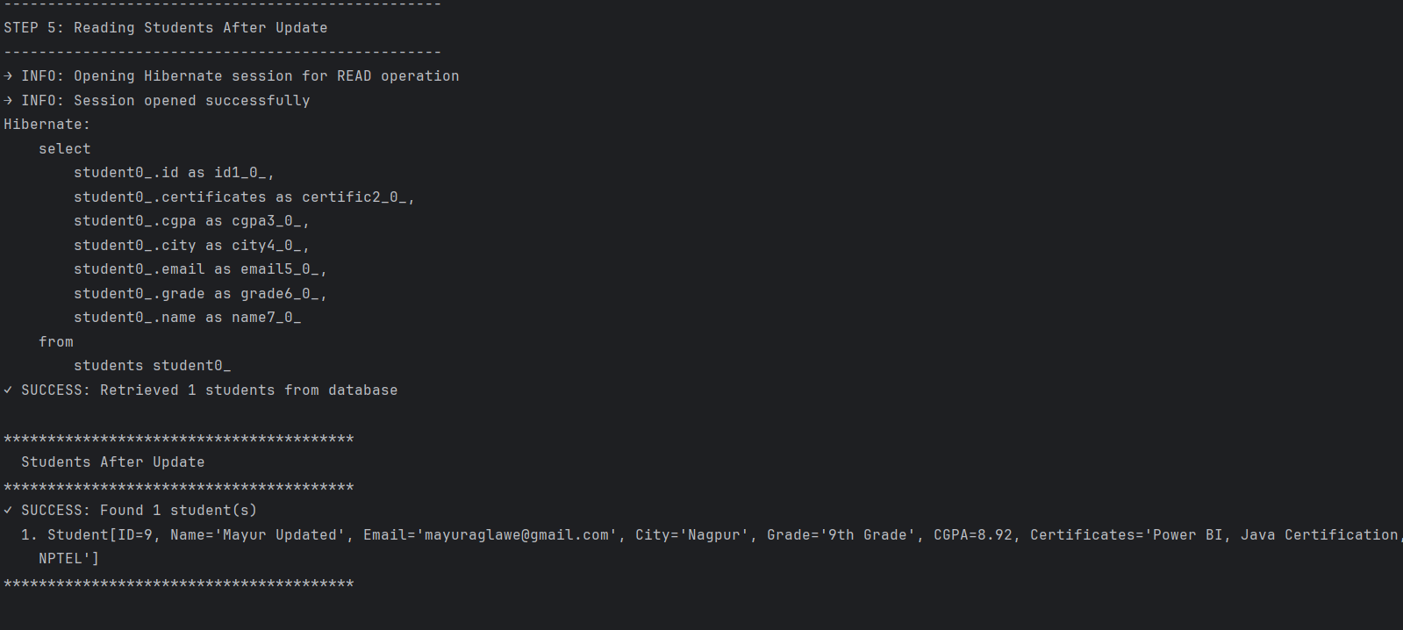
Output
01
02

Slide 12



THANK YOU
Mayur Aglawe
mayuraglawe06@gmail.com
mayuraglawe751@gmail.com

